Slide 1
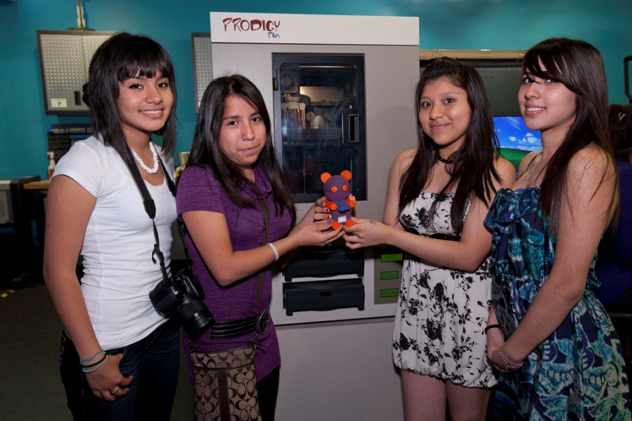
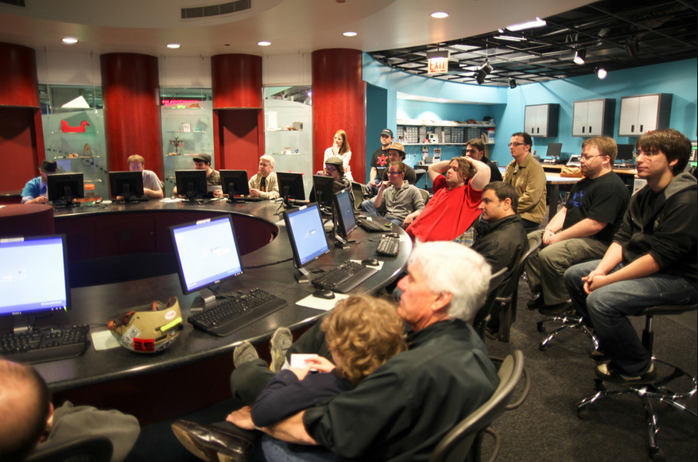
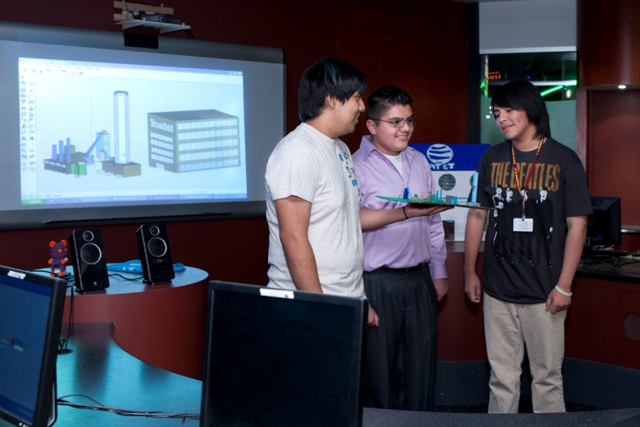
Fab Lab at Museum of Science and Industry, Chicago
Chicago, Illinois, USA
MSI Chicago
Fab Lab at MSI
Since Fab6
What’s Next?
http://www.msichicago.org/whats-here/fab-lab/
Contact us: fablab@msichicago.org
Notes:
MSI
largest science center in Western Hemisphere
First USA science center to do hands-on interactives
Last standing building of 1893 Columbian Exposition/World’s Fair
1.4M visitors in 2010
Fab Lab at MSI
Installed in 2004
1800 sq feet
Equipment – list out
Science Achievers
New leadership in 2010
Since Fab6
Hired full-time Manager
Launched Innovation Clubs
Engaged expert volunteers
Small-group workshops
Piloting public programs
Evaluation and assessment – learning outcomes
What’s Next
Expand Innovation Clubs
15 public workshops launched
Development of expert volunteer model
School system partnerships
Contributing to Fab education and evaluation resources
Open Access
FabOnline (check out session on Tues)

